Slide 1

Java EE:
JavaServer Pages
SoftUni Team
Technical Trainers
Software University
http://softuni.bg

Slide 2
Table of Contents
JavaServer Pages
Architecture
Processing
Servlet Filters

Slide 3
Questions
sli.do #java-web

Slide 4

JavaServer Pages
Overview

Slide 5

What are JavaServer Pages?(1)
Java Server Pages (JSP)
Server-side programming technology
Dynamic
Platform-independent
Method for building Web-based applications
JSP have access to the entire family of Java APIs

Slide 6

What are JavaServer Pages?(2)
JavaServer Pages (JSP):
Technology for developing Webpages that support:
Dynamic content.
Insertion of java code in HTML pages
Use of special JSP tags - <% … %>

Slide 7

What are JavaServer Pages?(3)
JavaServer Pages(JSP) component:
Type of Java servlet
Designed to fulfill the role of a user interface for a Java web
application
JSPs are text files that combine:
HTML
XHTML
XML
Embedded JSP actions and commands

Slide 8

What are JavaServer Pages?(4)
Using JSP, you can:
Collect input from users through:
Webpage forms
Present records from a database or another source
Create Webpages dynamically

Slide 9



What are JavaServer Pages?(5)
JSP tags purposes:
Retrieving information from a database
Registering user preferences
Accessing JavaBeans components
Passing control between pages
Sharing information between requests, pages etc

Slide 10

JSP Architecture(1)
The web server needs:
JSP engine, i.e, a container to process JSP pages
The JSP container:
Responsible for intercepting requests for JSP pages
Works with the Web server
Provides the runtime environment and other services a JSP needs
Knows how to understand the special elements that are part of JSPs

Slide 11
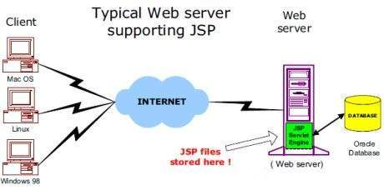
JSP Architecture(2)
Following diagram shows the position of JSP container and JSP files in a Web application.

Slide 12

JSP Processing(1)
Browser sends an HTTP request to the web server
Web server:
Recognizes that the HTTP request is for a JSP
Forwards it to a JSP engine using the URL or JSP page which ends with .jsp instead of .html

Slide 13

JSP Processing(2)
JSP engine:
Loads the JSP page from disk
Converts it into a servlet content:
Template text is converted to println( ) statements
All JSP elements are converted to Java code that implements the
corresponding dynamic behavior of the page

Slide 14

JSP Processing(3)
JSP engine:
Compiles the servlet into an executable class
Forwards the original request to a servlet engine
Servlet engine:
Loads the Servlet class and executes it:
The servlet produces an output in HTML format
Output is further passed inside a HTTP response

Slide 15
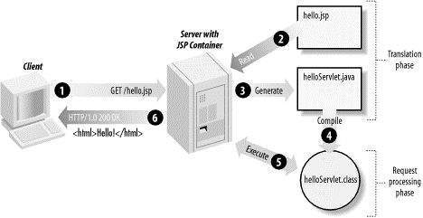
JSP Processing(4)
Web server:
Forwards the HTTP response to your browser
Web browser:
Handles the dynamically-generated HTML as if it is a static page

Slide 16
JavaServer Pages
Examples

Slide 17
Hello World!(1)
Servlet.java
@WebServlet("/")
public class Servlet extends HttpServlet {
private String message;
protected void init(…) {
this.message = “Hello World!”;
}
protected void doGet(…) {
request.setAttribute(“message”, this.message);
request.gerRequestDispatcher(“/home.jsp”).forward(request, response);
}
}

Slide 18
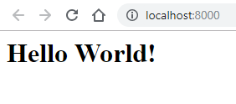
Hello World!(2)
home.jsp
<%@ page contentType="text/html;charset=UTF-8" language="java" %>
<html>
<head>
<title>HelloWorld!</title>
</head>
<body>
<h1><%= request.getAttribute("message") %></h1>
</body>
</html>

Slide 19
Register Users!(1)
HomeServlet.java
@WebServlet("/")
public class HomeServlet extends HttpServlet {
protected void doGet(…) {
request.gerRequestDispatcher(“/home.jsp”).forward(request, response);
}
}

Slide 20
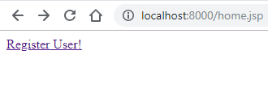
Register Users!(2)
home.jsp
<%@ page import="java.util.List" %>
<%@ page import="domain.User" %>
<%@ page contentType="text/html;charset=UTF-8" language="java" %>
<html>
<head>
<title>Register Users!</title>
</head>
<body>
<a href="/register">Register User!</a>
<% if ((request.getSession().getAttribute("users")) != null && ((List<User>)request.getSession().getAttribute("users")).size() > 0) {%>
<h2>Our Users!</h2>
<% for (User user : ((List<User>) request.getSession().getAttribute("users"))) {%>
<p><%= String.format("Username: %s; Password: %s;", user.getUsername(), user.getPassword())%></p>
<%}%>
<% }%>
</body>
</html>

Slide 21
Register Users!(3)
RegisterServlet.java
@WebServlet("/register")
public class RegisterServlet extends HttpServlet {
private List<User> users;
protected void doGet(…) {
if (this.users == null) {
this.users = new ArrayList<>();
request.getSession().setAttribute("users", this.users);
}
request.getRequestDispatcher("/register-user.jsp").forward(reqest, response);
}
protected void doPost(…) {
String username = request.getParameter("username");
String password = request.getParameter("password");
this.users.add(new User(username, password));
response.sendRedirect("home.jsp");
}
}

Slide 22
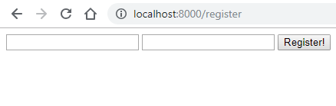
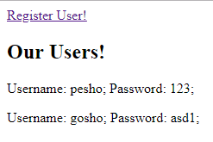
Register Users!(4)
register-user.jsp
<%@ page contentType="text/html;charset=UTF-8" language="java" %>
<html>
<head>
<title>Register Users!</title>
</head>
<body>
<form action="/register" method="post">
<label for="usernameId">
<input type="text" id="usernameId" name="username">
</label>
<label for="passwordId">
<input type="password" id="passwordId" name="password">
</label>
<button>Register!</button>
</form>
</body>
</html>

Slide 23

Filters
Overview

Slide 24

What are Servlet Filters?
Servlet Filters:
Pluggable java components
Used to intercept and process:
Requests before they are sent to servlets
Response after servlet code is finished and before container
sends it back to the client

Slide 25
Servlet Filter Tasks
Filter tasks:
Logging request parameters to log files
Authentication and authorization of request for resources
Formatting of request body or header before sending it to
servlet
Compressing the response data sent to the client
Alter response by adding some cookies, header information etc.

Slide 26
Servlet Filter interface(1)
Servlet Filter interface:
Similar to Servlet interface
Managed by servlet container
Contains lifecycle methods of a Filter:
init() method – called when container initializes the filter
doFilter() method – called when container needs to apply filter to a resource. FilterChain parameter is used to invoke the next filter in the chain
destroy() method

Slide 27
Servlet Filter Configuration
web.xml
<?xml version = "1.0" encoding = "UTF-8"?>
<web-app xmlns:xsi="http://www.w3.org/2001/XMLSchema-instance"
xmlns="http://java.sun.com/xml/ns/javaee"
xmlns:web="http://java.sun.com/xml/ns/javaee/web-app_2_5.xsd"
xsi:schemaLocation="http://java.sun.com/xml/ns/javaee
http://java.sun.com/xml/ns/javaee/web-app_2_5.xsd"
id="WebApp_ID" version="2.5">
<filter>
<filter-name>ServletFilter</filter-name>
<filter-class>demo.web.filters.ServletFilter</filter-class>
</filter>
<filter-mapping>
<filter-name>ServletFilter</filter-name>
<url-pattern>/*</url-pattern>
</filter-mapping>
</web-app>

Slide 28
Servlet Filter class
ServletFilter.java
@WebFilter("/ServletFilter")
public class ServletFilter implements Filter {
public void doFilter(…) {
HttpServletRequest req = (HttpServletRequest) request;
HttpServletResponse resp = (HttpServletResponse) response;
req.getSession().setAttribute("username", "pesho");
chain.doFilter(req, resp);
}
}

Slide 29




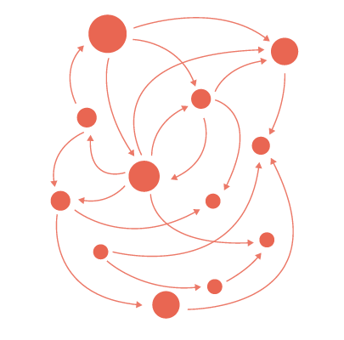

Summary
JavaServer Pages:
Server-side programming technology.
Enables the creation of dynamic,
platform-independent method for building
Web-based applications.
Servlet Filters:
Pluggable java components
Used to intercept and process
requests and responses

Slide 30
https://softuni.bg/trainings/courses

Slide 31













SoftUni Diamond Partners

Slide 32




SoftUni Organizational Partners

Slide 33




Trainings @ Software University (SoftUni)
Software University – High-Quality Education and Employment Opportunities
softuni.bg
Software University Foundation
http://softuni.foundation/
Software University @ Facebook
facebook.com/SoftwareUniversity
Software University Forums
forum.softuni.bg

Slide 34

License
This course (slides, examples, demos, videos, homework, etc.) is licensed under the "Creative Commons Attribution-NonCommercial-ShareAlike 4.0 International" license

